Slide 1
Fortran basic-2
Week-2

Slide 2
格式化輸入輸出Formatted I/O
Read
Free format
read(*,*), write(*,*)
Formatted I/O
read(*,’(1x,I3)’)i
read(*,10)I
10 format(1x,I3)
Write
Free format
write(*,*)
Formatted I/O
write(*,’(3x,A4)’)’test’
write(*,10)’test’
10 format(3x,A4)

Slide 3
Format
X output space
I output integer
F output real
A output character and string
E output real in an exponent format

Slide 4
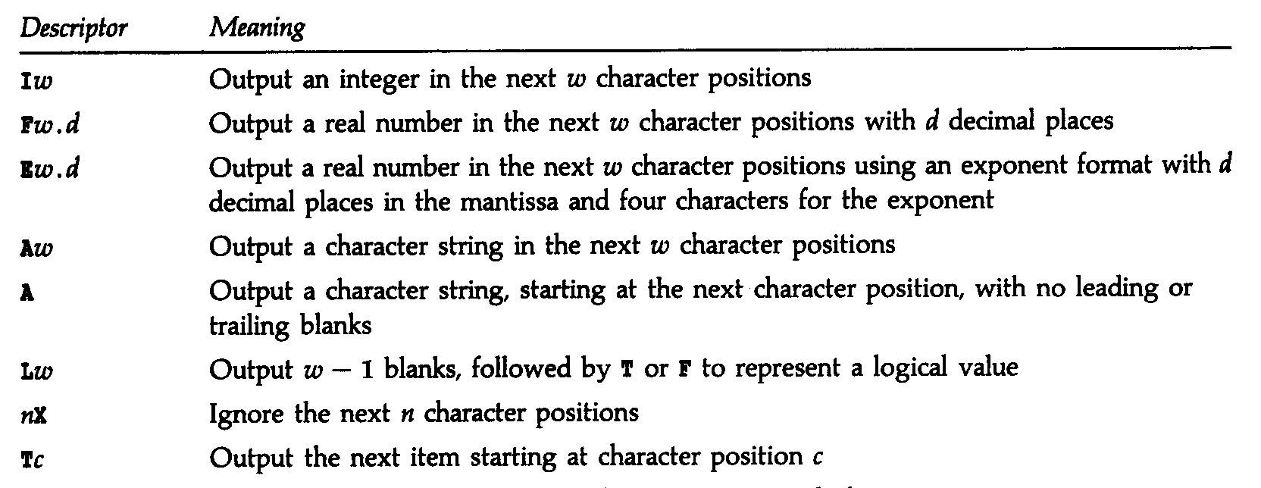

Slide 5
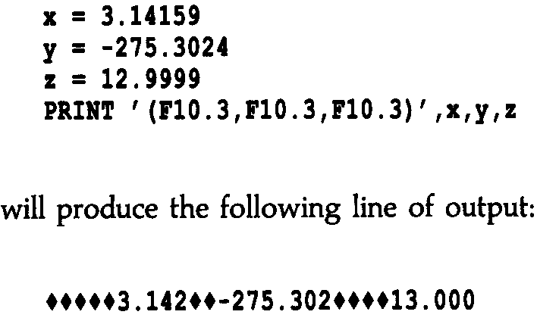

Slide 6
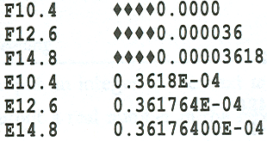

Slide 7
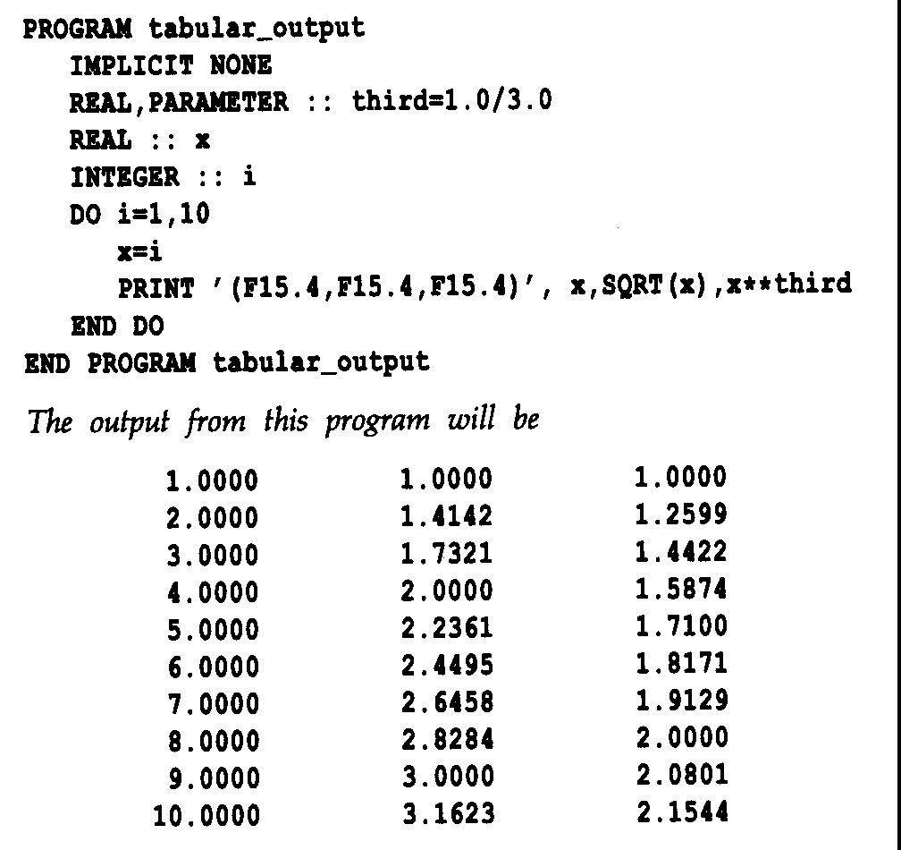

Slide 8
Others
Iw[.m]
Write(*,’(I3)’)10 ➔_10
Write(*,’(I4.3)’)10 ➔_010
Ew.d[Ee]
Write(*,’(E15.7)’)123.45 ➔__0.1234500E+03
Write(*,’(E9.2E3)’)12.34 ➔_0.12E002

Slide 9
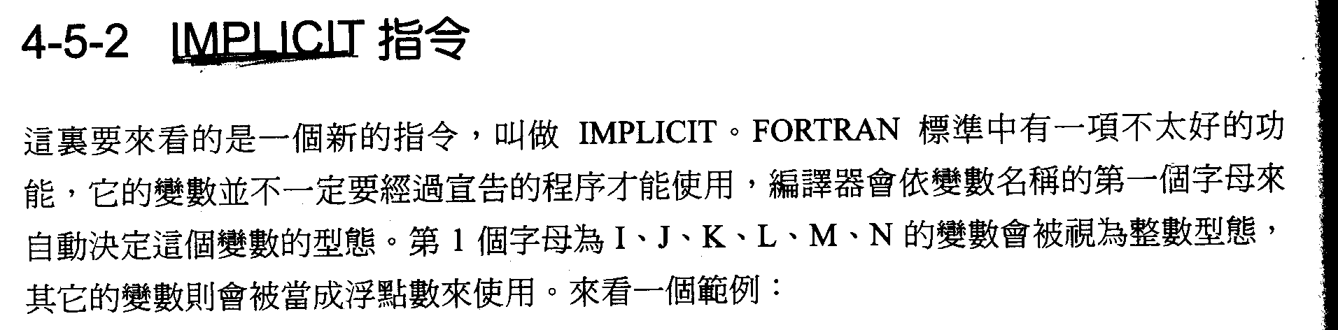
Implicit to give internal definition type
Implicit integer (A,B,C, I-N)
!---initial A, B, C, I, J, K M, N’s variable will be defined as integer
Implicit real (x-z) !– initial x, y, z’s variable will be defined as real
Implicit none !– close default settings

Slide 10
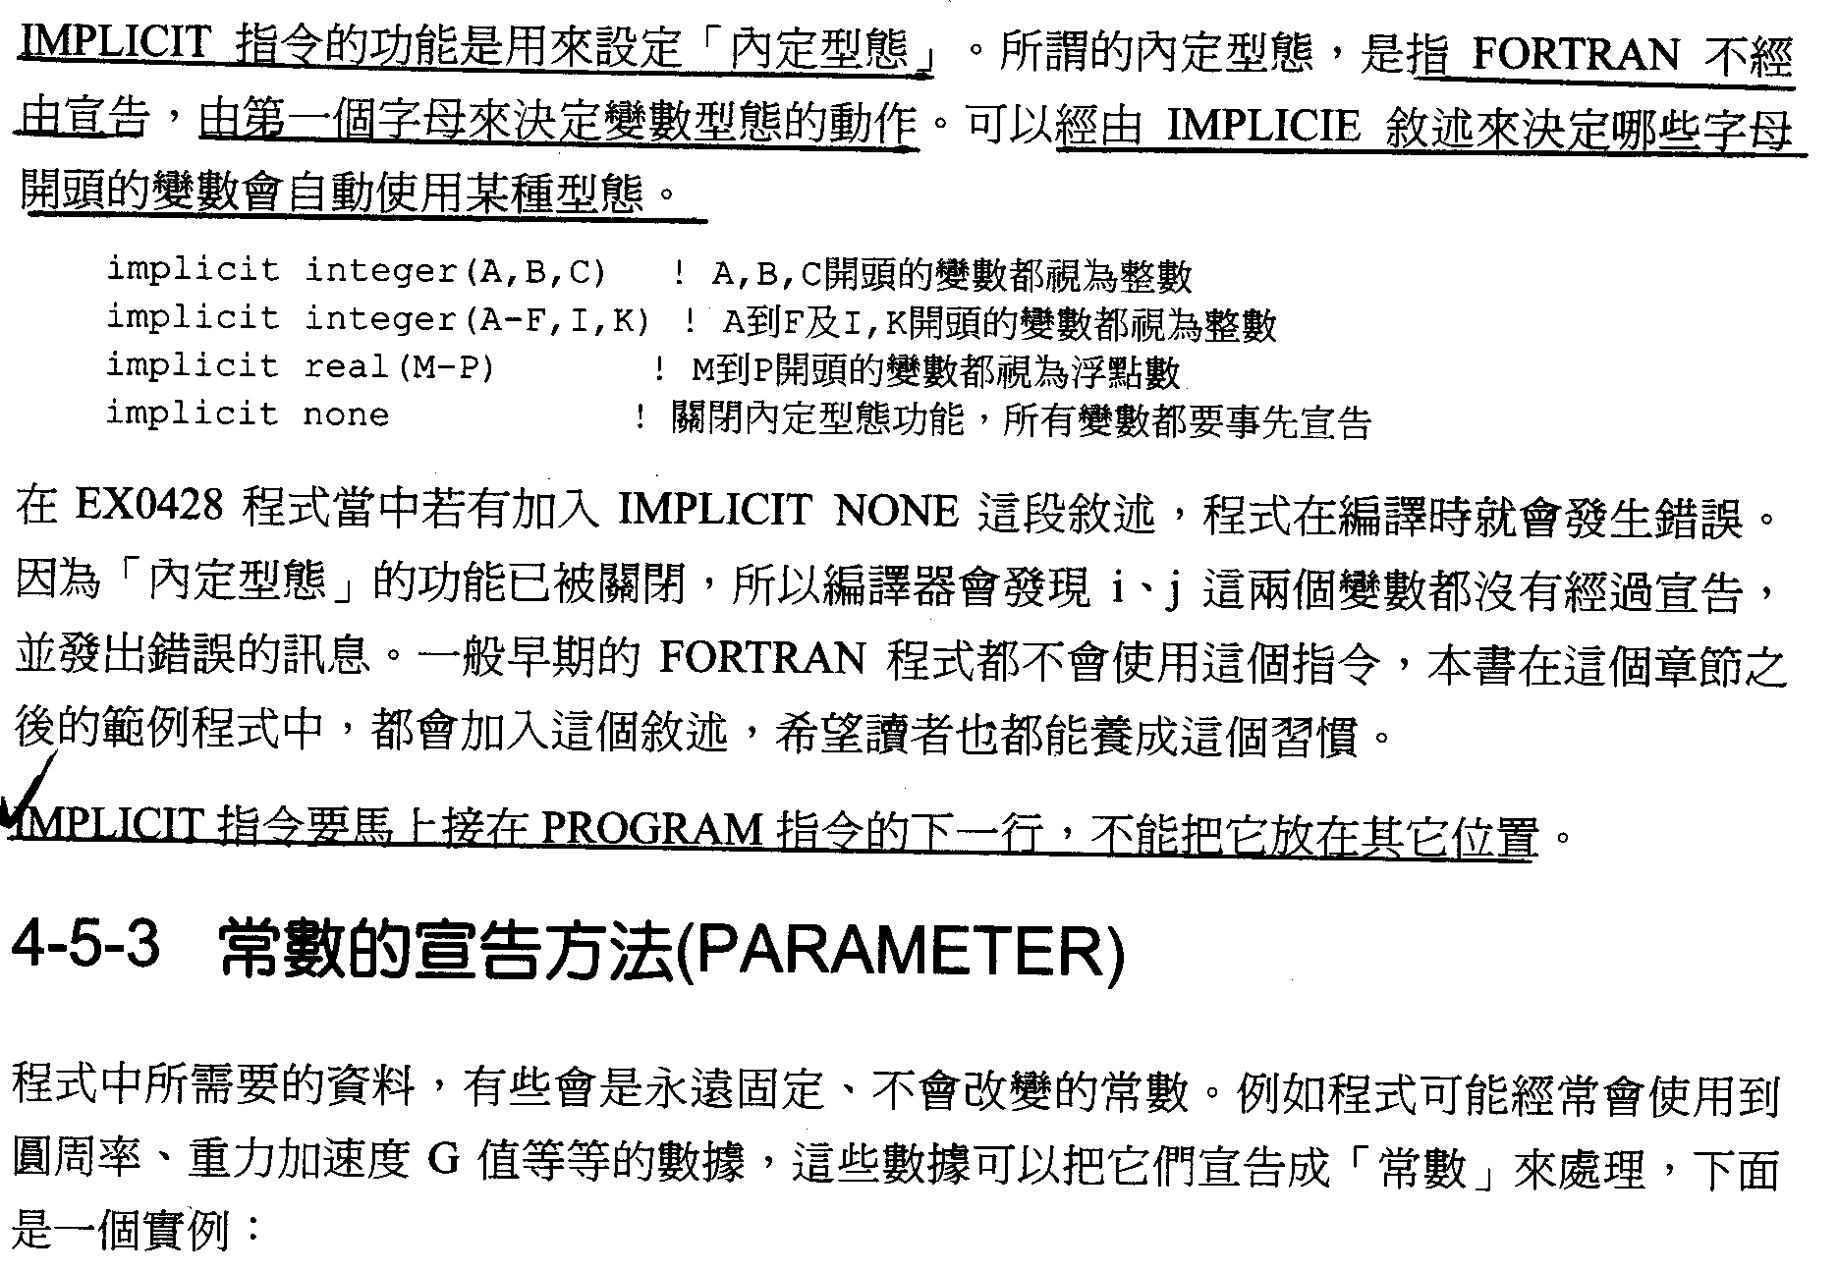

Slide 11
parameter
Parameter (pi=3.141592654)
Real, parameter :: pi=3.141592654

Slide 12
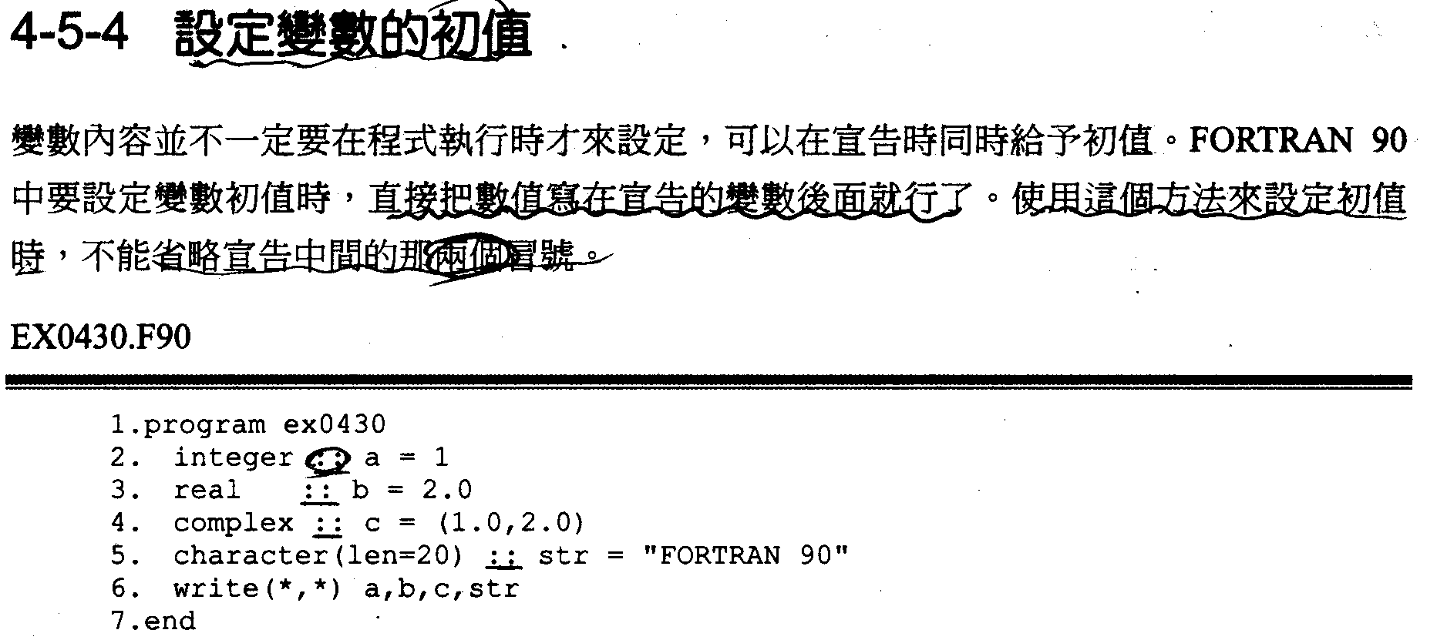
Declare and give initial value F90
Integer :: b=2000
Complex :: c=(2,4)
F77 use data

Slide 13
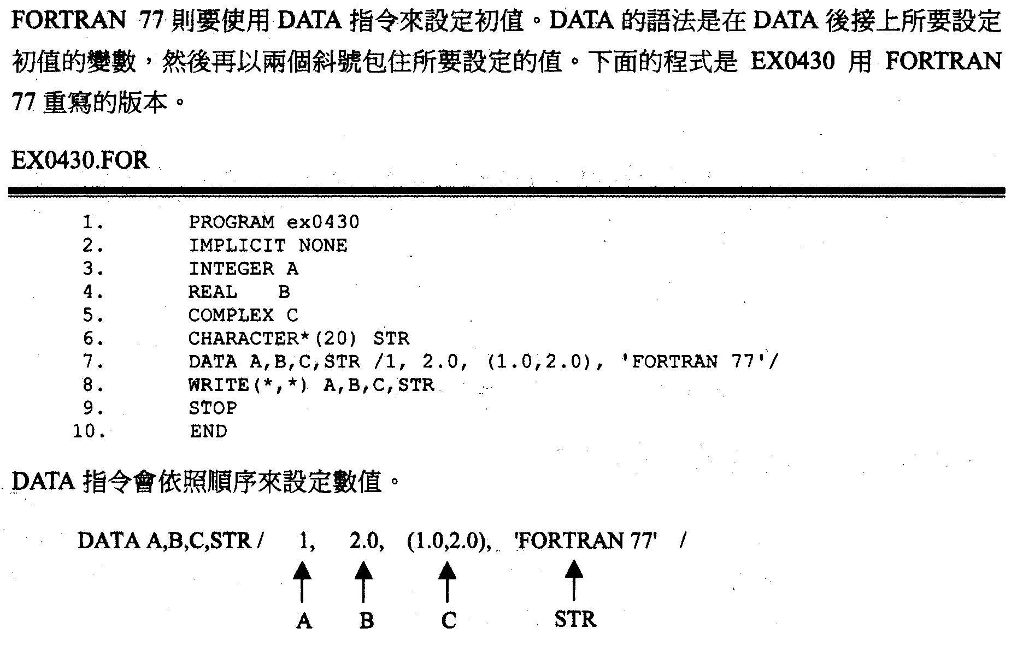

Slide 14
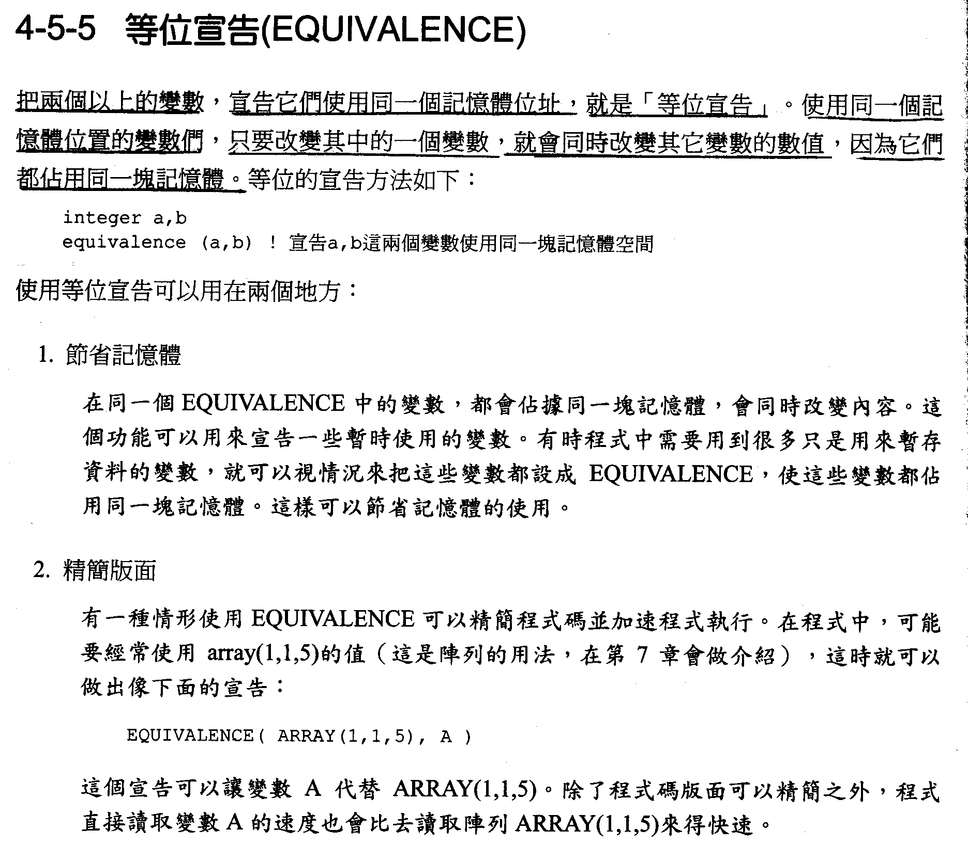

Slide 15
等位宣告(Equivalence)
Assign two (or more) variables to a memory address. If a new value is assigned to one of the variables, the other variables will have the same value (because they share the same memory).
Equivalence statement:
Two reasons to use Equivalence statement:
1. Save memory:
if the program will use some variables temporarily, we can state these variables as EQUIVALENCE to make them use the same memory for saving memory.
2. Simplify code:
some code can be simplified and speeded up with EQUIVALENCE. For example: if array(1,1,5) is commonly use in a program, an Equivalence can be stated:
Therefore, A represents ARRAY(1,1,5) after this Equivalence
statement. Except a more simplified code, reading A is faster than
reading ARRAY(1,1,5).
integer a, b
equivilance (a, b) ! variables a, b are assigned to share a same memory
EQUIVALENCE( ARRAY(1,1,5), A)

Slide 16
Equivalence 運用
用於解碼 for decode
Integer*2 A
Character B(2)
Equivalence (A,B)
A=27890
B(1),B(2)分別表示High and Low Bytes
Some systems need to change High and Low Bytes

Slide 17
IF Basic

Slide 18
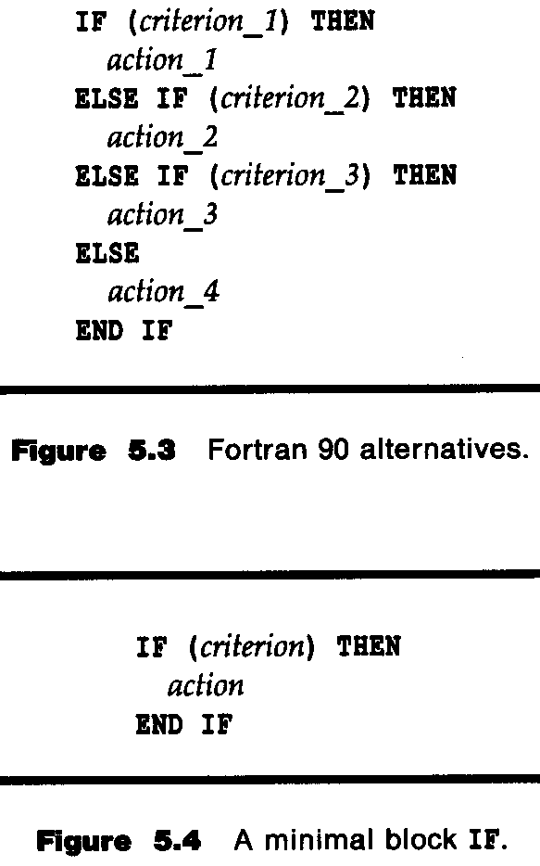
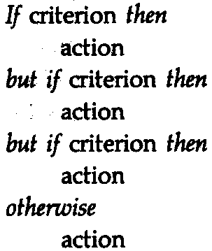

Slide 19
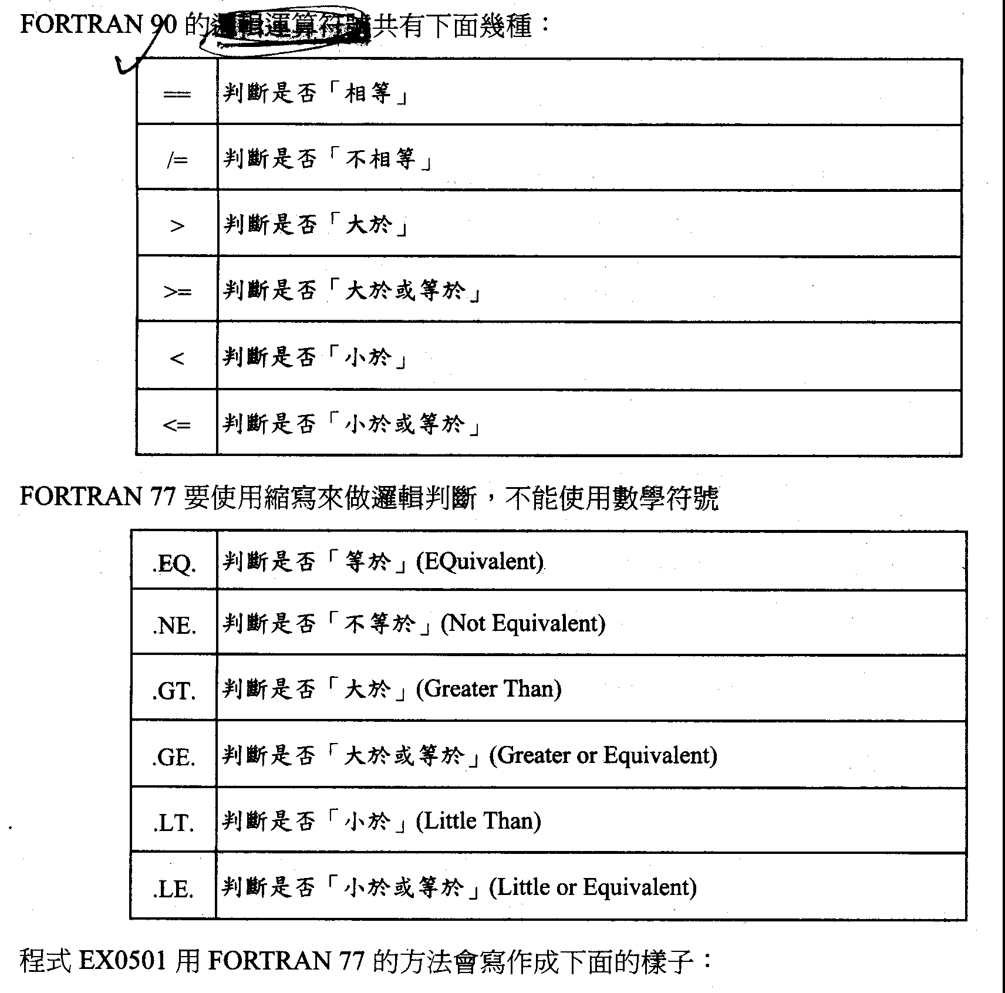
F90 sign of logical operator
== equivalent
/= not equivalent
> greater
>= greater or equivalent
< smaller
<= smaller or equivalent

Slide 21
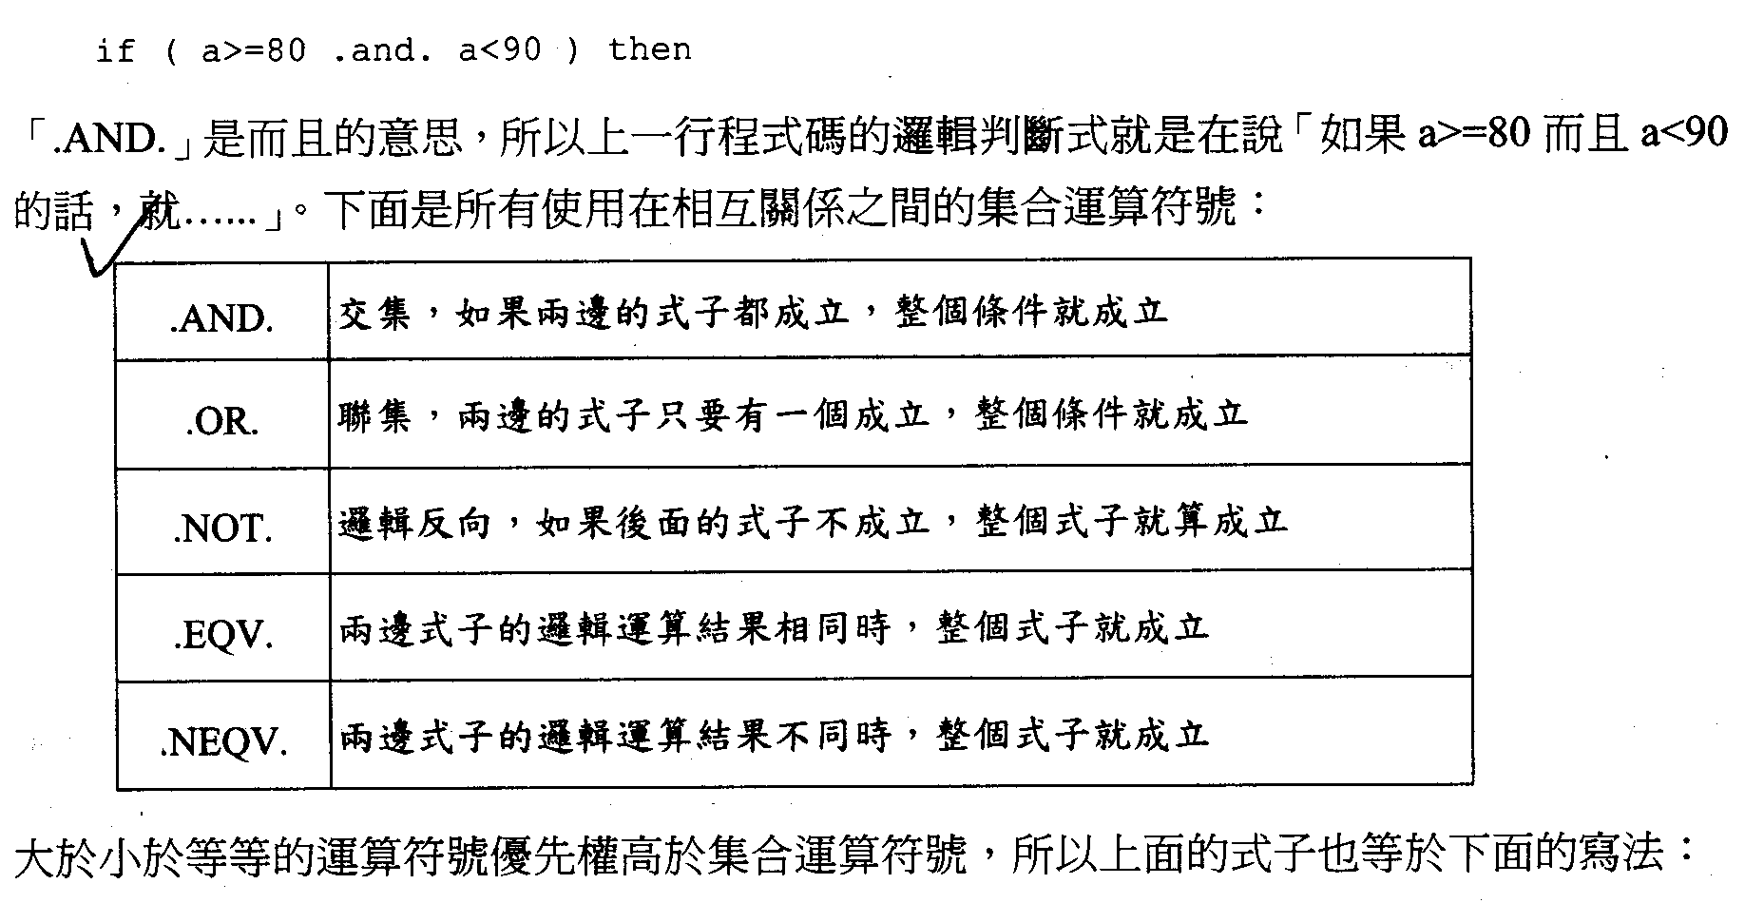

Slide 22
if ( a>=80 .and. a<90 ) then
“.AND.” means “and”, so the code above is literally saying:
“if a is greater or equal to 80 and a is less than 90, then do …”
Here is the list of logical operators:
Relational operators (>, <, ==, /=, >=, <=) have higher priority than logical operators.
.AND. | Intersection. If the operands at both sides are non-zero, then condition becomes true.
.OR. | Union. If any of the operands at both sides is non-zero, then condition becomes true.
.NOT. | Reverses the logical state of the operand. If a condition is true, .NOT. operator will make false.
.EQV. | If two logical values are equal, the condition is true.
.NEQV. | If two logical values are not equal, the condition is true.

Slide 23
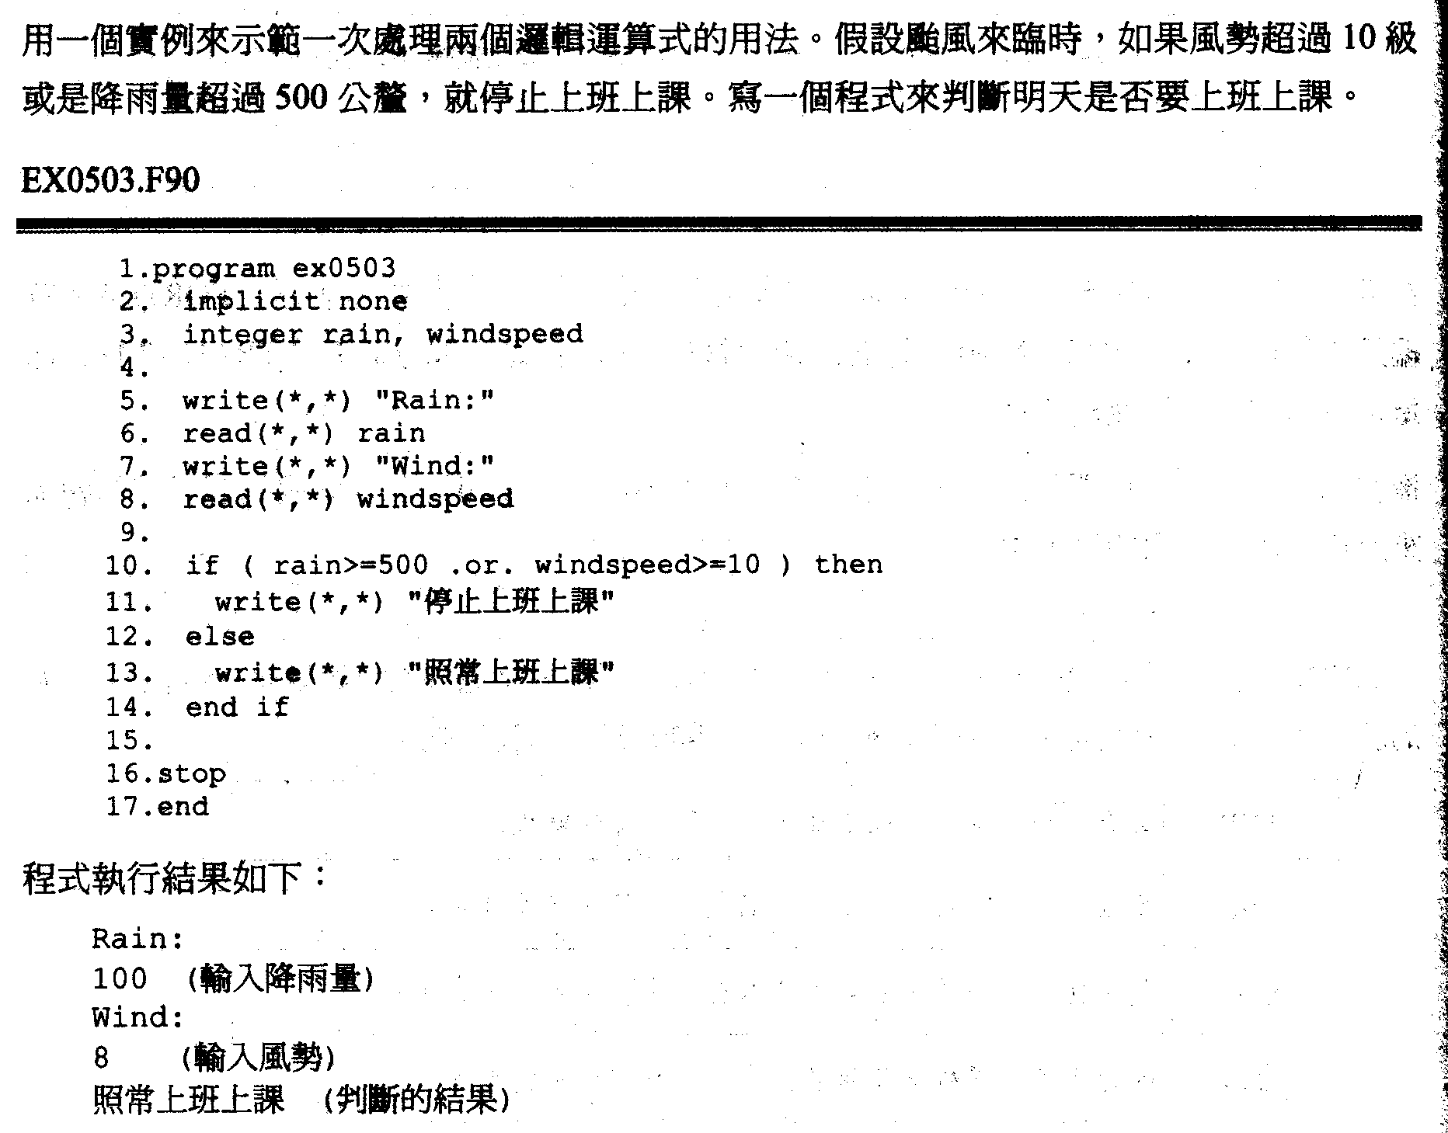

Slide 24
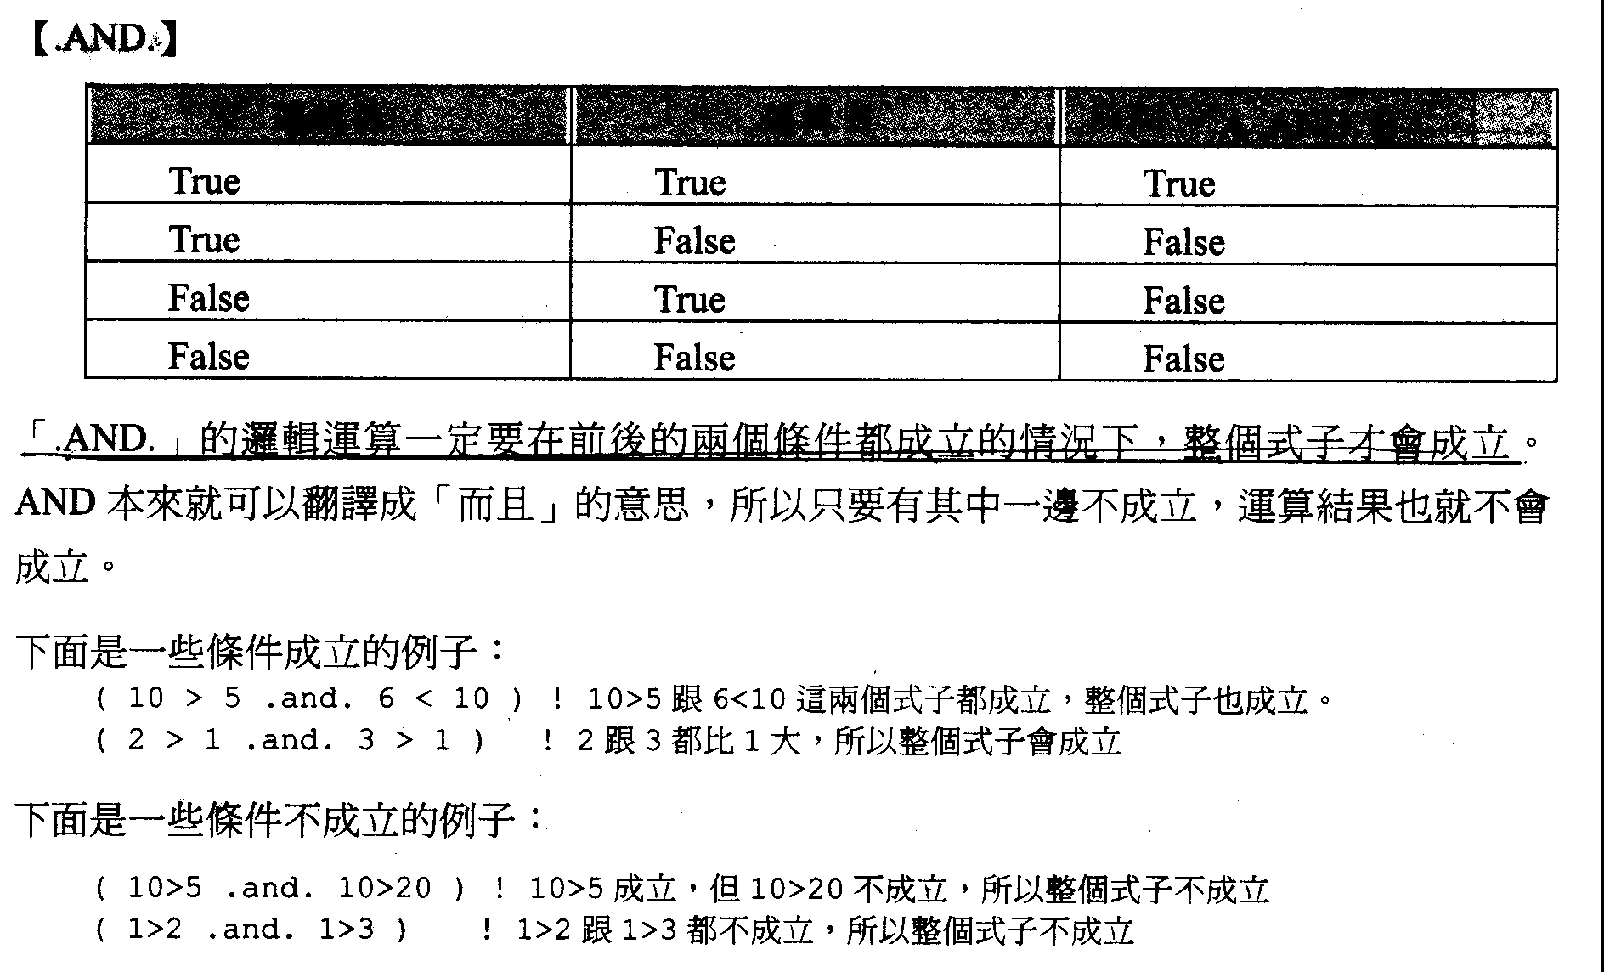

Slide 25
【.AND.】
“.AND.” will be true only when both of the two conditions are true.
Examples of “true” cases:
Examples of “false” cases:
Variable A | Variable B | A .AND. B
True | True | True
True | False | False
False | True | False
False | False | False
( 10 > 5 .and. 6 < 10 ) ! Both of 10>5 and 6<10 are true, so it’s true in the end
( 2 > 1 .and. 3 > 1 ) ! Both of 2 and 3 are greater than 1, so it’s true in the end
( 10 > 5 .and. 10 > 20 ) ! 10>5 is true but 10>20 is false, so it’s false in the end
( 1 > 2 .and. 1 > 3 ) ! Both of 1>2 and 1>3 are false, so it’s false in the end

Slide 26
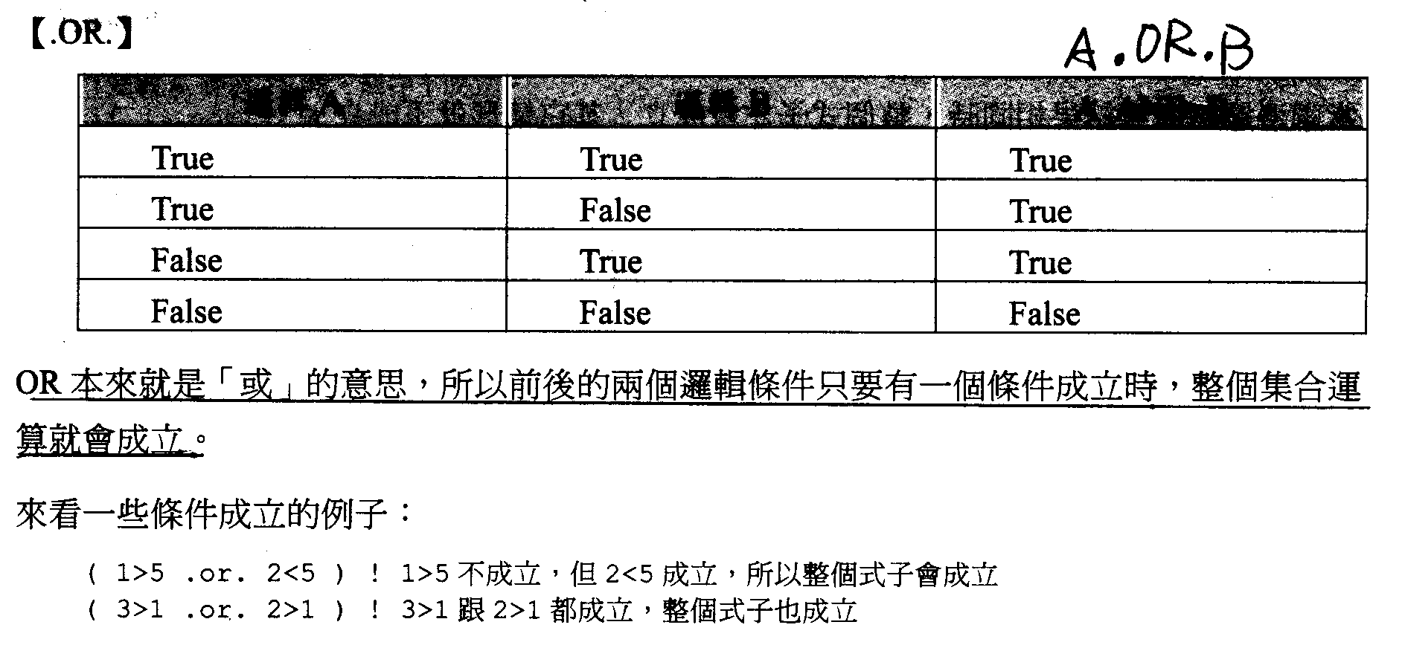

Slide 27
【.OR.】
“.OR.” will be true if at least one of the two conditions is true.
Examples of “true” cases:
Variable A | Variable B | A .OR. B
True | True | True
True | False | True
False | True | True
False | False | False
( 1 > 5 .or. 2 < 5 ) ! 1>5 is false but 2<5 is true, so it’s true in the end
( 3 > 1 .or. 2 > 1 ) ! Both of 3>1 and 2>1 are true, so it’s true in the end

Slide 28
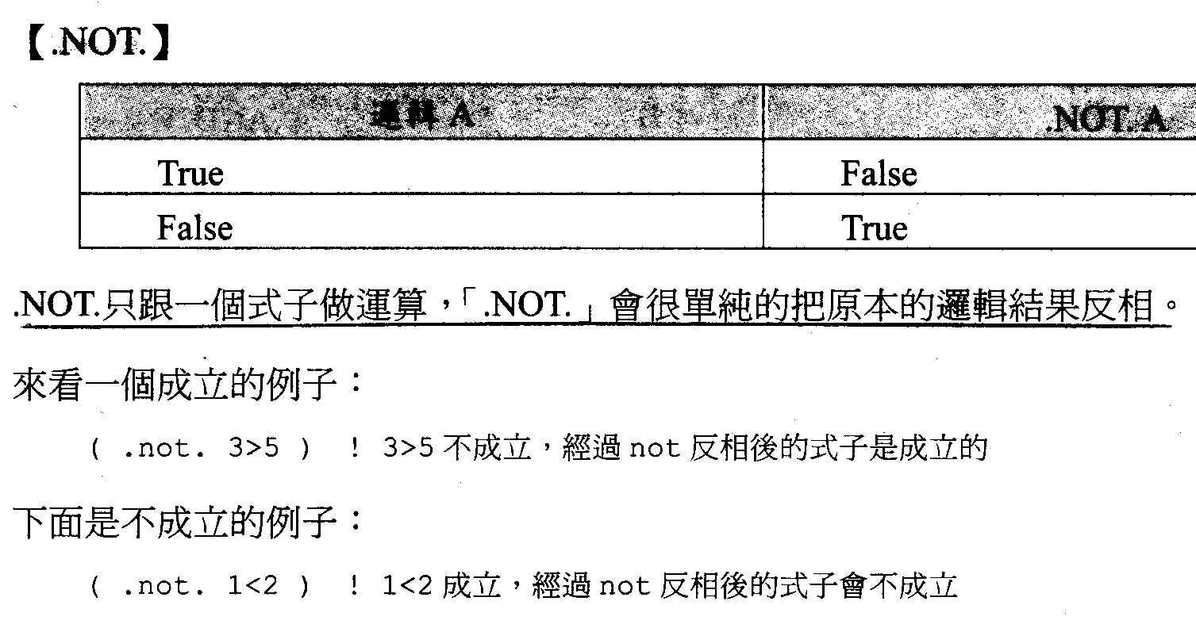

Slide 29
【.NOT.】
“.NOT.” is only operated with one condition. It reverses the logical state of the condition.
Examples of a “true” case:
Examples of a “false” case:
Variable A | .NOT. A
True | False
False | True
( .not. 3 > 5 ) ! 3>5 is false, but it becomes true after reversion
( .not. 1 < 2 ) ! 1<2 is true, but it becomes false after reversion

Slide 30
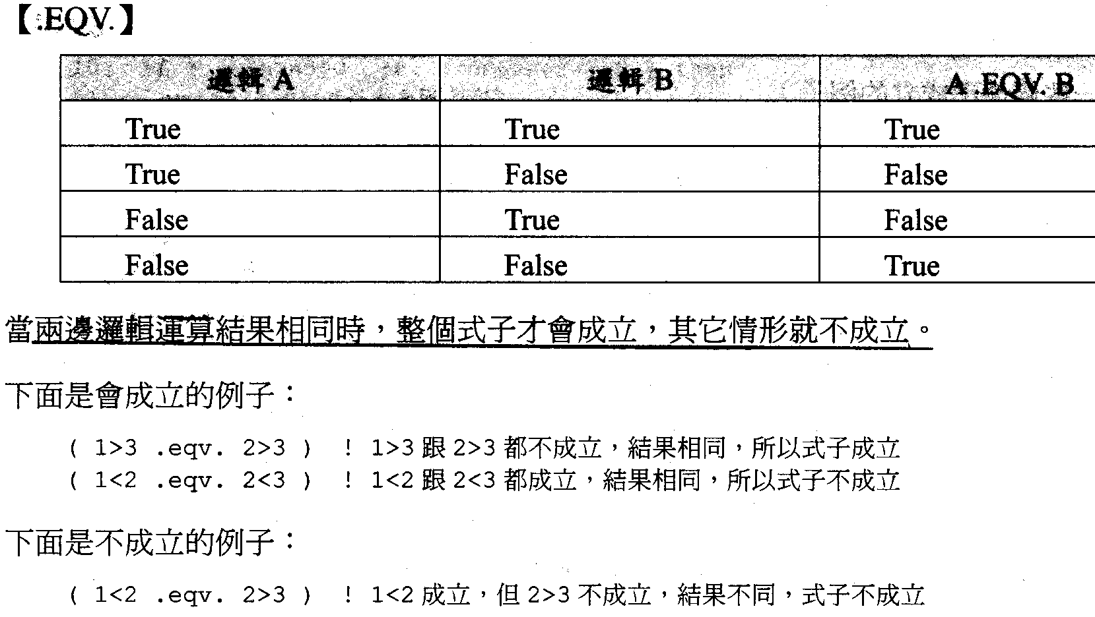

Slide 31
【.EQV.】
“.EQV.” is true only when both of the two conditions have same logical state.
Examples of “true” cases:
Examples of a “false” case:
Variable A | Variable B | A .EQV. B
True | True | True
True | False | False
False | True | False
False | False | True
( 1 > 3 .eqv. 2 > 3 ) ! Both of 1>3 and 2>3 are false, so it’s true in the end
( 1 < 2 .eqv. 2 < 3 ) ! Both of 1<2 and 2<3 are true, so it’s true in the end
( 1 < 2 .eqv. 2 > 3 ) ! 1<2 is true but 2>3 is false, so it’s false in the end

Slide 32
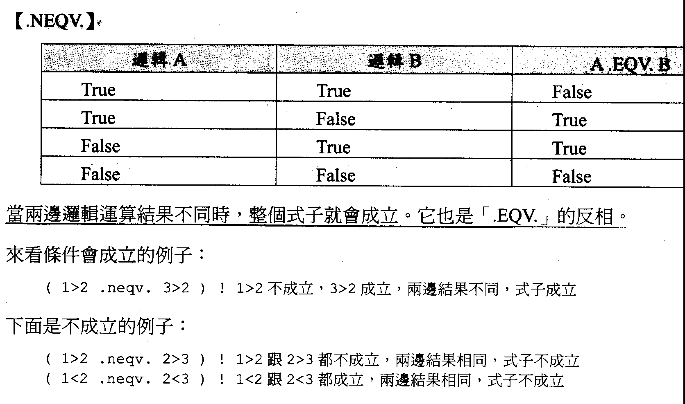

Slide 33
【.NEQV.】
“.NEQV.” is true only when both of the two conditions have different logical states. It is the opposite of “.EQV.”
Examples of “true” cases:
Examples of a “false” case:
Variable A | Variable B | A .NEQV. B
True | True | False
True | False | True
False | True | True
False | False | False
( 1 > 2 .neqv. 3 > 2 ) ! 1>2 is false and 3>2 is true. It’s true in the end
( 1 > 2 .eqv. 2 > 3 ) ! Both of 1>3 and 2>3 are false, so it’s false in the end
( 1 < 2 .eqv. 2 < 3 ) ! Both of 1<2 and 2<3 are true, so it’s false in the end

Slide 34
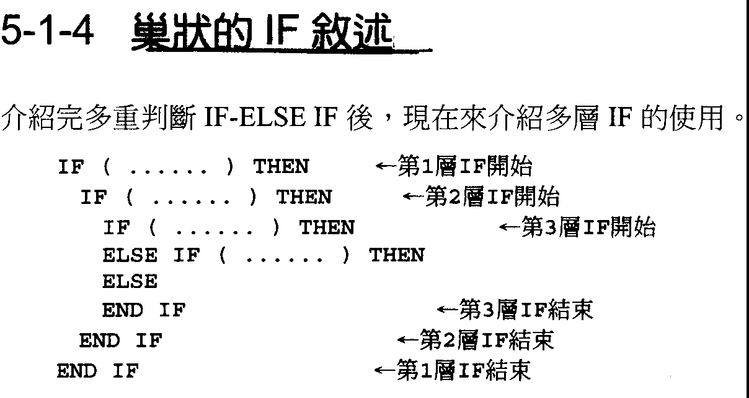

Slide 35
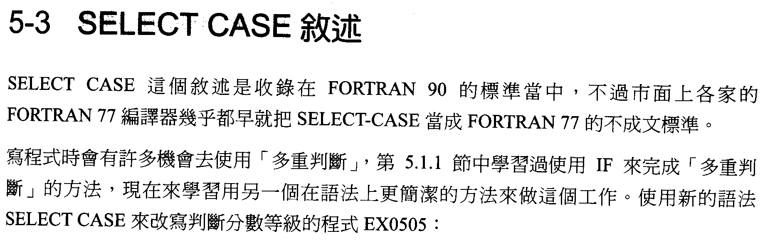

Slide 36
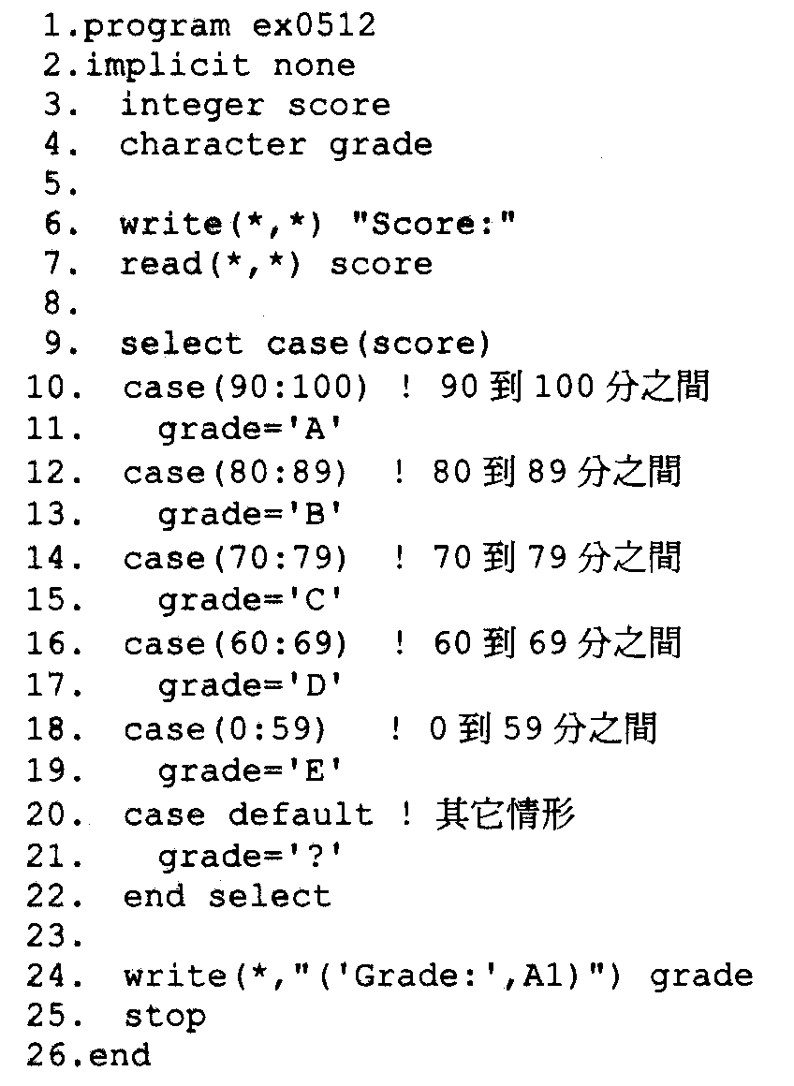

Slide 37
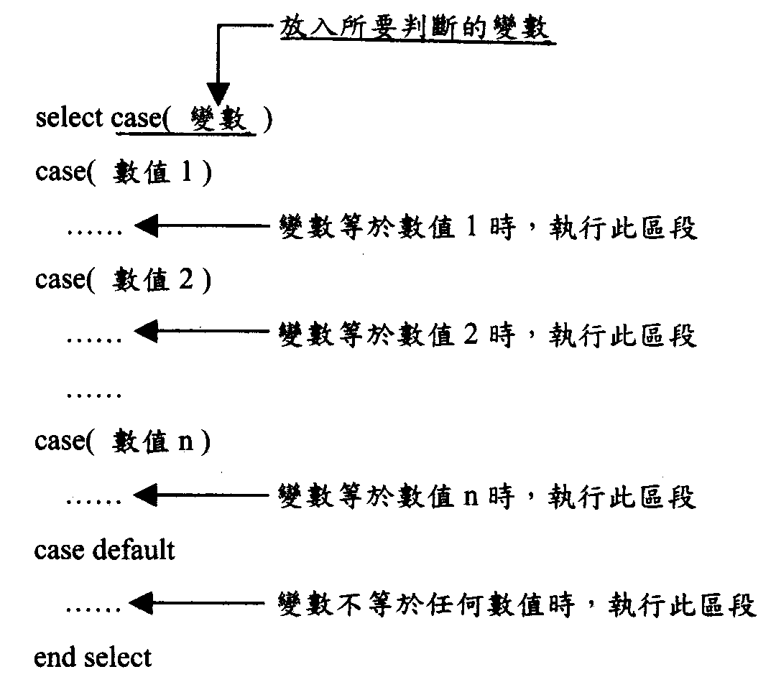

Slide 38
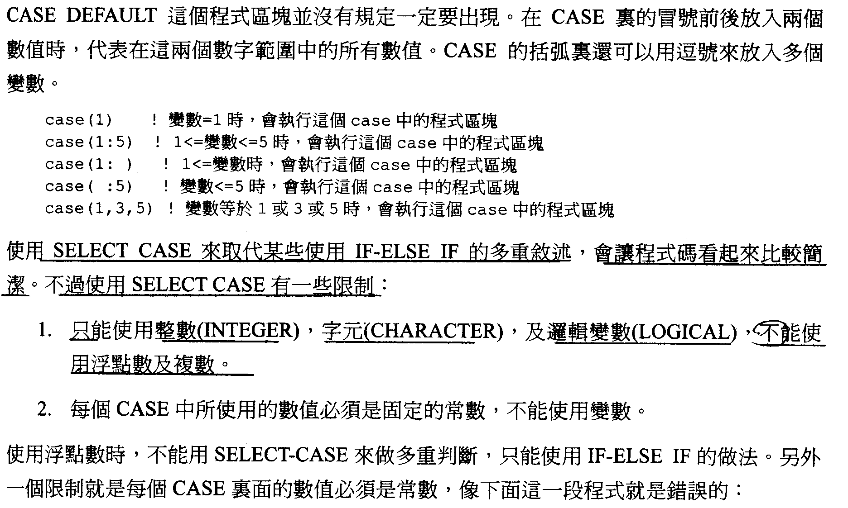

Slide 39
SELECT CASE can be used to replace a bunch of IF-ELSE IF conditions, to make a concise code.
Two numbers (a, b) can be put at two sides of a colon in the bracket behind case, to indicate a range of values between the two numbers.
Rules for SELECT CASE:
1. Only INTEGER, CHARACTER, and LOGICAL can be used in conditions.
REAL and COMPLEX are not allowed.
*Although REAL cannot be used as conditions in case(). It can be used in
IF-ELSE IF conditions.
2. All the values in case() should be constant. Variables are not allowed.
The following example shows the wrong using of CASE:
case(1) ! when the tested variable=1, the conditional code in this case will be executed
case(1:5) ! when 1<= tested variable <=5, the code in this case will be executed
case(1: ) ! 1<= tested variable, the code in this case will be executed
case( : ) ! tested variable <=5, the code in this case will be executed
case(1,3,5) ! when tested variable is 1 or 3 or 5, the code in this case will be executed

Slide 40
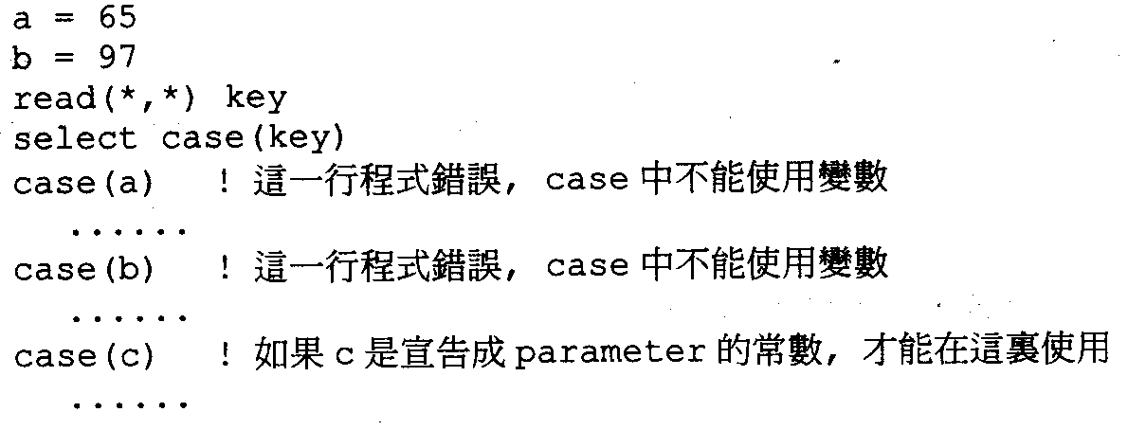

Slide 41
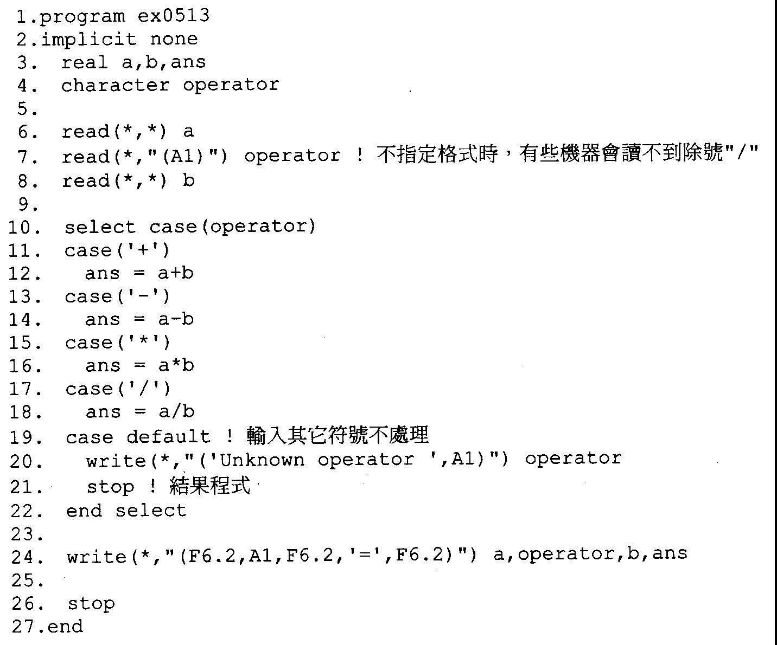

Slide 42
goto, continue, if, pause
i=0
10 continue
i=i+1
print *,I
pause ‘Checking!’
if (i .gt. 100) goto 20
goto 10
20 print*,i

Slide 43
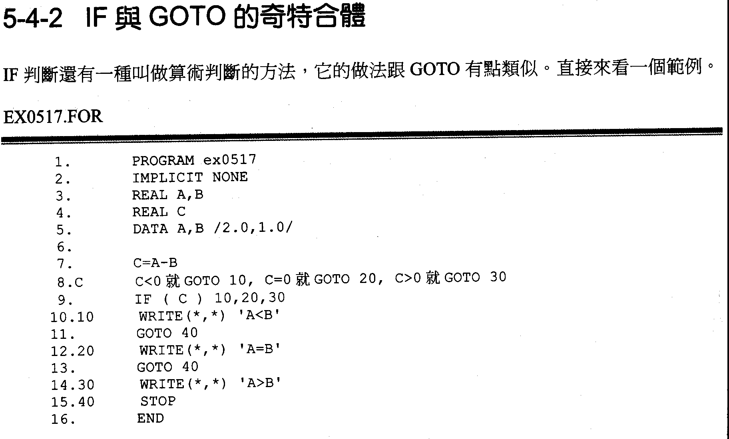

Slide 44
Homework 2-1
Please write the guess number game 1A2B. Right number and Right position give ‘A’, Right number and wrong position give ‘B’. Input 3 digit can not repeat. Using GOTO to be a loop and guess 3A then exit the loop.

Slide 45
Open and close
Open(1,file=‘test.txt’,status=‘old’)
Open(2,file=‘output.txt’,status=‘unknown’)
10 Read(1,*,end=99)a,b,c
Read(1,’(1x,f4.2,f5.3)’,end=99)a,b
write(2,’(2f10.3)’)a,b/c
goto 10
99 close(1)

Slide 46
Homework 2-2
Please read the latitude and longitude from the earthquake catalog (1999.lis) and using excel to plot the epicenter distribution map.
1999 1 1 032 26.482252.5712041.46 15.971.82 5 15.6190 .42 2.6 3.0 F 10D 01010032.P99
1999 1 1 054 41.662354.9512044.58 10.692.04 6 7.3174 .18 .8 .7 F 11C 01010054.P99
1999 1 1 055 46.172428.0812153.01 9.792.53 7 15.1249 .32 1.7 1.8 F 13D 01010054.199
1999 1 1 131 51.842416.5512148.46 10.072.7219 7.7194 .42 1.8 1.0 F 28D 01010131.P99
1999 1 1 212 24.152312.8112015.03 18.642.3717 7.2110 .29 1.0 1.1 F 27B 01010212.P99
1999 1 1 250 41.782313.1012014.72 22.242.33 6 7.1130 .25 1.3 1.5 F 12B 01010250.P99
1999 1 1 7 0 14.702226.7112054.78 11.432.9414 9.9169 .27 .7 .8 F 28C 01010700.P99
1999 1 1 737 40.892420.0912146.67 56.922.4510 11.0193 .29 2.4 1.9 F 18D 01010737.P99
1999 1 1 750 20.632227.8712057.85 9.772.29 3 13.8258 .05 .4 .7 F 6D 01010750.P99
1999 1 1 8 0 43.942227.5012054.44 10.002.44 7 11.2196 .27 1.2 2.1 X 14D 01010800.P99
1999 1 1 934 56.212449.7012153.92 80.734.3651 16.8162 .33 1.0 .9 F 90C 01010934.P99

Slide 47
program hk21
character a(3),b(3)
10 print*,'Input initial three number'
read(*,'(3a1)') (a(i),i=1,3)
do i=1,3
if(a(i) <'0' .or. a(i)>'9')goto 10
enddo
if(a(1) .eq. a(2) .or. a(1).eq.a(3)) goto 10
if(a(2) .eq. a(3)) goto 10
20 print*,'Input three number'
read(*,'(3a1)') (b(i),i=1,3)
do i=1,3
if(b(i) <'0' .or. b(i)>'9')goto 20
enddo
if(b(1) .eq. b(2) .or. b(1).eq.b(3)) goto 20
if(b(2) .eq. b(3)) goto 20
ia=0
do i=1,3
if(a(i) .eq. b(i))ia=ia+1
enddo
ib=0
if(a(1).eq.b(2) .or. a(1).eq.b(3)) ib=ib+1
if(a(2).eq.b(1) .or. a(2).eq.b(3)) ib=ib+1
if(a(3).eq.b(1) .or. a(3).eq.b(2)) ib=ib+1
if(ia.eq.3)then
print*,'nice job!'
else
write(*,'(3x,i1,a1,i1,a1)')ia,'A',ib,'B'
goto 20
endif
end program hk21

